Slide 1

Secure File Vault
Your Files. Your Password. Your Privacy.
Browser-Based Encryption and Cloud Synchronization
KISHORE C - URK25CS6017
JOSHUA DANIEL S - URK25CS6045
F.JESWINFRANK - URK25CS6021

Slide 2
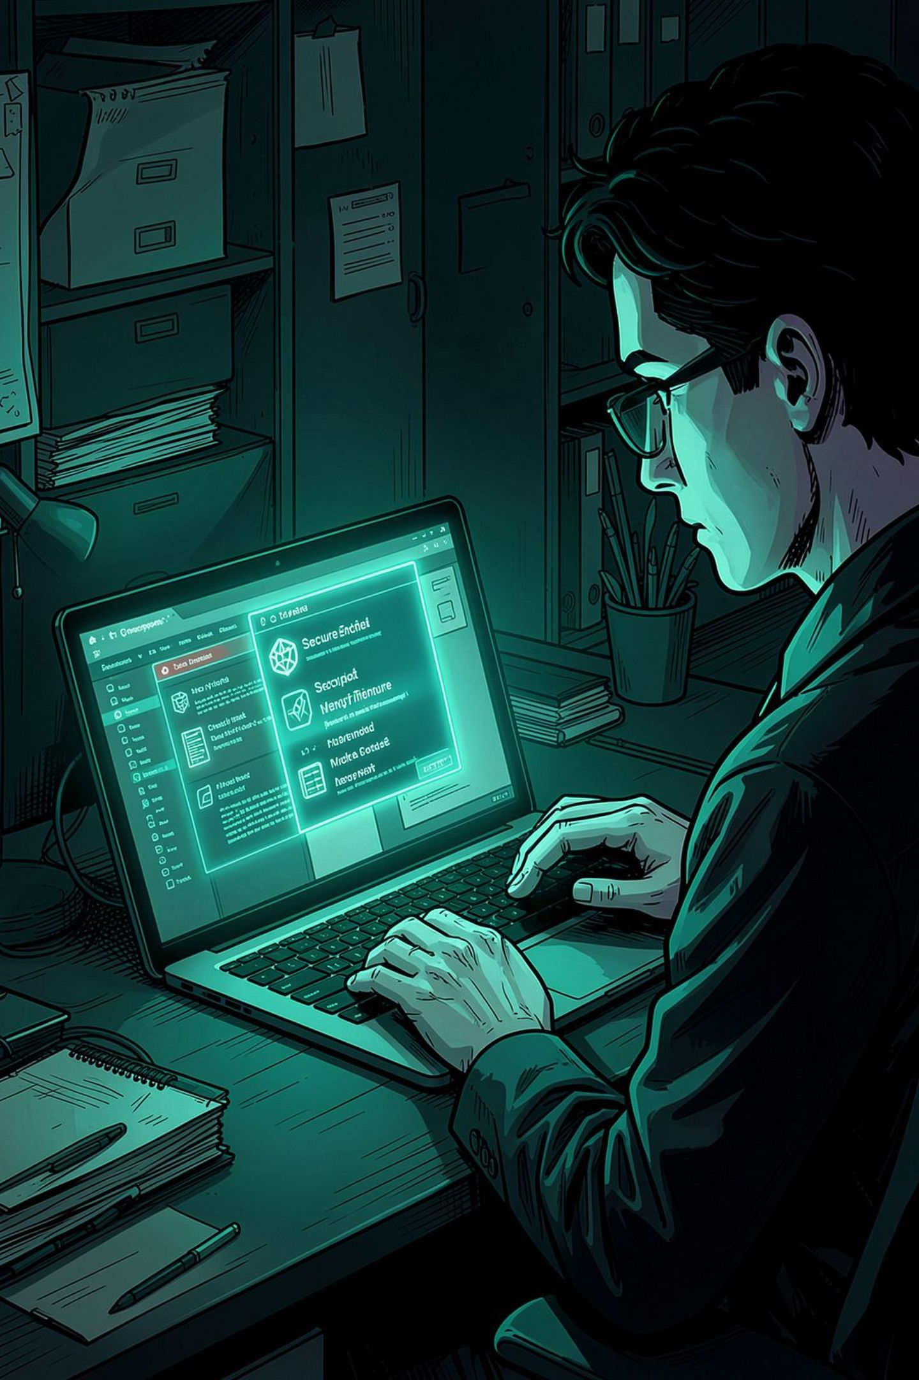
Introduction
Password-Based Encryption
Protects sensitive files using strong password-derived keys — no key stored anywhere.
Client-Side Processing
Files are encrypted entirely inside the browser before any cloud upload occurs.
Hybrid Storage
Combines local IndexedDB with optional Supabase cloud storage for resilient access.
Full Management Suite
File management, account access, activity monitoring and admin oversight included.

Slide 3






Objectives and Technologies
Security Objectives
Technology Stack
AES-256-GCM Encryption
Authenticated encryption ensuring both confidentiality and data integrity.
Frontend
Crypto API
HTML, CSS, JavaScript
Web Crypto API
PBKDF2-SHA-256 Key Derivation
250,000 iterations of key stretching to resist brute-force attacks.
Local Store
Cloud
SHA-256 Fingerprints
IndexedDB, localStorage
Supabase + PostgreSQL
File integrity verification through cryptographic hash comparison on every restore.

Slide 4

System Architecture
Frontend
Encryption Layer
Storage Layer
Metadata Layer
The system follows a layered architecture where all cryptographic operations occur client-side before data reaches any storage layer. When cloud connectivity is unavailable, a local IndexedDB fallback ensures uninterrupted access.

Slide 5
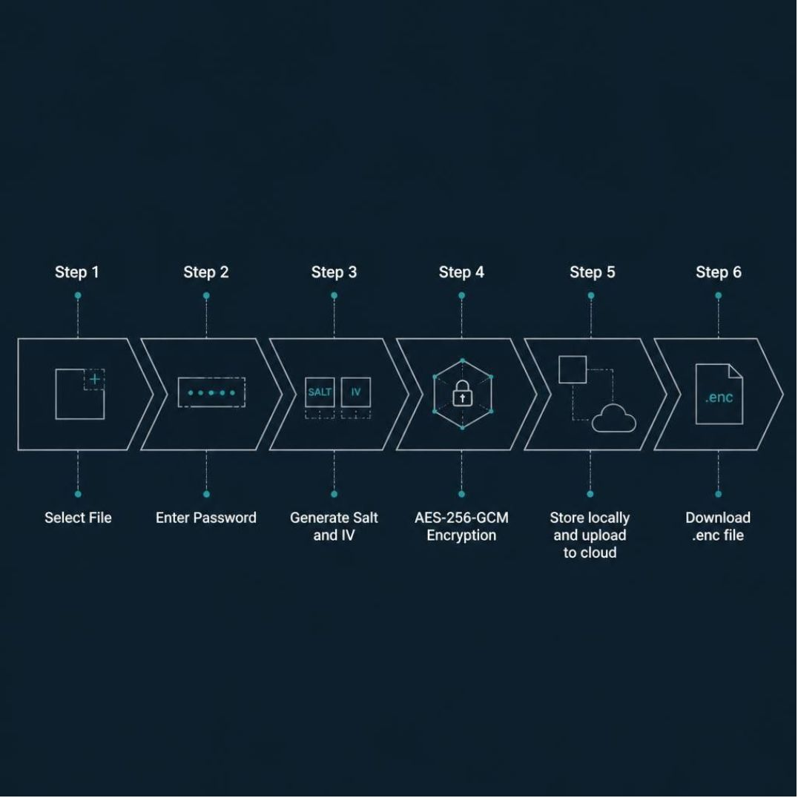
Encryption and Decryption Workflow
Encrypt
01
Select file → Enter password
02
Generate random salt and IV
03
AES-256-GCM encryption applied
04
Store locally + upload to cloud → Download .enc
Decrypt
01
Enter password → Authenticate user
02
Decrypt file → Restore filename and contents
03
Verify SHA-256 fingerprint for integrity

Slide 6





Key Features
Authentication
Encryption & Integrity
Hybrid Cloud Sync
Registration, login and admin access with real-time password strength feedback and breach detection.
Supabase and Storage synchronization with seamless local fallback when cloud is unavailable.
AES-256-GCM file encryption, decryption and management with SHA-256 integrity checks on every operation.
Activity Monitoring
Lockout Mechanisms
Tamper-evident activity logs with hash-chain verification ensuring audit trail integrity.
5 failed login attempts triggers a 60-second lockout; file auto-deleted after 3 failed decryption attempts.

Slide 7
User Interface and Modules
1
Login / Register
Account access with password strength checks and integrated breach detection on sign-up.
2
Encrypt / Decrypt
Secure file processing interface with live integrity verification using SHA-256 fingerprints.
3
My Files
File history, restoration and deletion management with cloud and local storage views.
4
Activity Log
Chronological security event timeline with hash-chain log verification for tamper detection.
5
Admin Panel
User management interface providing administrative oversight of accounts and activity.
6
Settings
Theme customization (dark/light modes, color palettes) and Supabase connectivity configuration.

Slide 8


Testing, Results and Limitations
Test Scenarios
Expected Results
Correct and incorrect password attempts
✅ Strong Encryption
✅ Resilient Fallback
Tampered file detection and fingerprint comparison
Encrypted files are completely unreadable without the correct password.
Cloud failures trigger automatic local IndexedDB fallback with no data loss.
File restoration and SHA-256 verification
Known Limitations
Cloud upload/download and login lockout
Cloud Dependency
Browser-Side Controls
Sync relies on correct Supabase configuration and active permissions.
Client-side logic can be inspected or manipulated by determined adversaries.
Activity-log hash-chain verification

Slide 9





Conclusion and Future Scope
What We Built
Future Roadmap
Browser-based encryption with hybrid cloud storage
Server-Side Authorization
AES-256-GCM protection before any upload occurs
Two-Factor Authentication
File management, breach checks and activity monitoring
Automated Testing Suite
Improved Cloud Access Controls
Thank You — Questions & Answers

